Slide 1
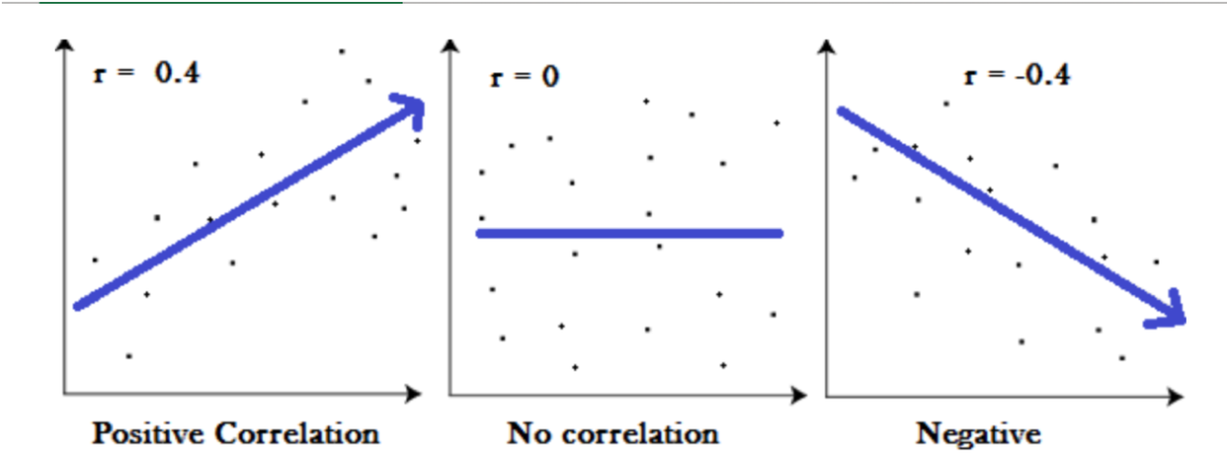
Statistic for Machine Learning
Linear vs Non-Linear Data
Covariance
Correlation
Application in ML

Slide 2
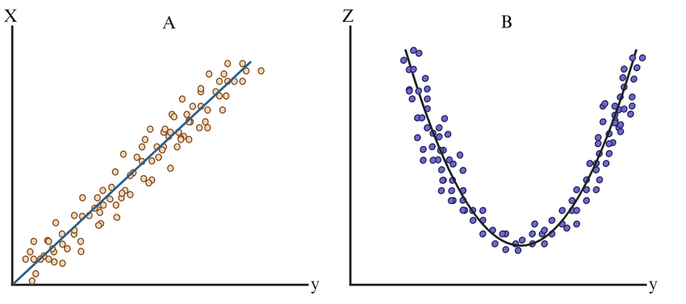
Linear Vs Non-Linear Data
Linear Data: Data is linear when the relationship between the independent variable(s) and the dependent variable
can be represented with a straight line Formula: y=mx+c
Non-Linear Data: Data where the relationship follows a curve or complex function, not a straight line. Formula:
y=ax2+bx+c
X (Input) | Y (Linear: y = 2x + 1) | Y (Non-Linear: y = x²)
1 | 3 | 1
2 | 5 | 4
3 | 7 | 9
4 | 9 | 16
5 | 11 | 25

Slide 3
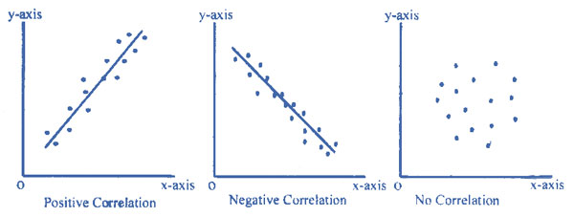
Covariance
Covariance measures the direction of linear relationship between two variables
Positive Covariance → variables increase together.
Negative Covariance → one increases, the other decreases.

Slide 4
Correlation
Correlation is a scaled version of covariance that measures both the strength and direction of the relationship.

Slide 5
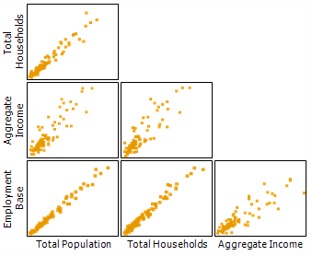
Multi-Coliniarity
Multicollinearity occurs when two or more independent (predictor) variables in a regression model are highly correlated with each other

Slide 6
Applications in Machine Learning
Use Case | Type | Description
Feature Selection | Correlation | Remove redundant features
Principal Component Analysis (PCA) | Covariance Matrix | Reduce dimensionality
Multicollinearity Detection | Correlation Matrix | Avoid overfitting in regression
Exploratory Data Analysis (EDA) | Both | Understand data structure
Pearson, Spearman, Kendall | Correlation | Different correlation types

